Slide 1

Guess Game2024
Assignment 3
Std. Robert-Gabriel Bărbulescu
Std. Ovidiu-Costin Ungureanu

Slide 2

Used this year at CyberMAN(Who cares?)
Three step challenge
Progressive difficulty
Overall hard for beginners

Slide 3
Good to have:
Kali Linux / Remnux
abd
apktool
Python
Frida / Objection (Tricky to setup)

Slide 4
Challenge context:
Flag format: CTF{Base64(part1 xor part2 xor part3)}
Hint 1: Where are strings stored in an APK file?
Flag 1: "$trings_are_1mp0rt4nt_123"
Hint 2: How would a log-eating cat perform a side channel attack?
"side_channeL_attak_bhuj"
Maybe some swiss army knife tool will be helpful, or idk, I already solved this problem
"Fr1da_1s_l1k3_swiss_4rmy_kn1f3"
- Final flag: CTF{EW8naFBbKk1QcDF4XVN3M3psGFMoWDY4BQ==}

Slide 5
CTF Purpose
Learning something new, like Android apps structure
Learning about Logcat
Learning about Frida

Slide 6
First steps:
Install the app either by using “adb” on a real phone or on an emulator
Open it
Try to play with it

Slide 7
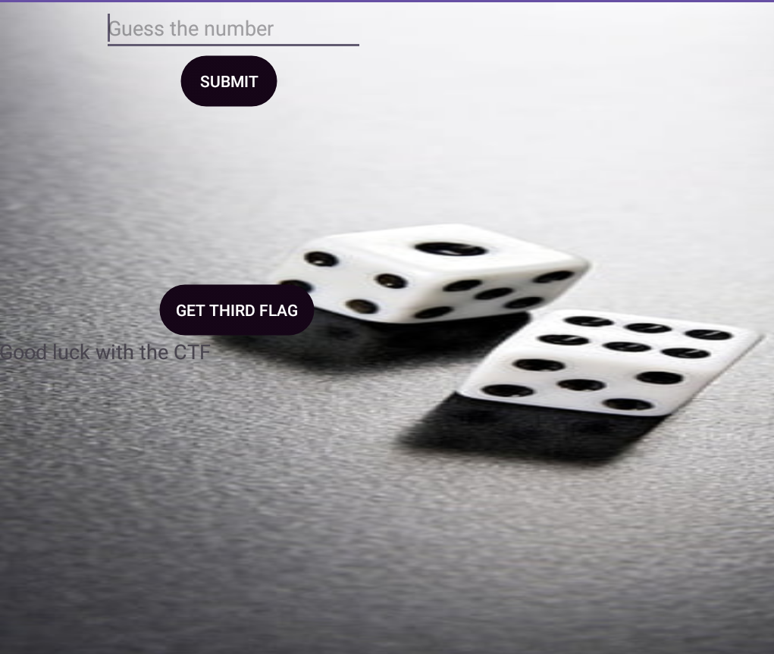

Slide 8
Decompile
Look through files for something juicy( Like the first flag)
-> res/values/strings.xml

Slide 9
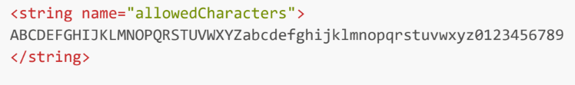
More info in this file:
Logcat tells us things about the input:
Bad length password
Bad password: „X number” miliseconds
Well done! You guessed the password, here is the flag: …
Python and ADB will solve this using not 62^5 combinations, but 62*5.

Slide 10
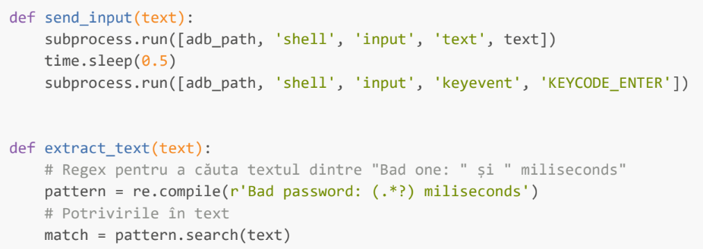

Slide 11
What does “GET THIRD FLAG” button ?
What can be found in logs?
Wrong phone number
Again, strings file helps us

Slide 12
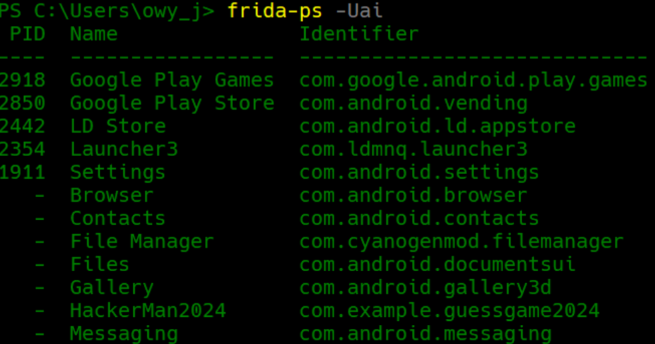
Frida

Slide 13
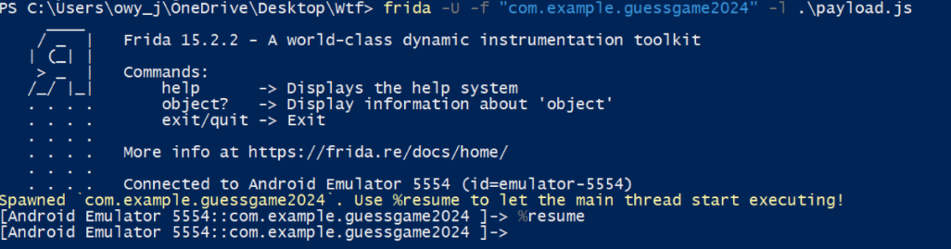

Slide 14
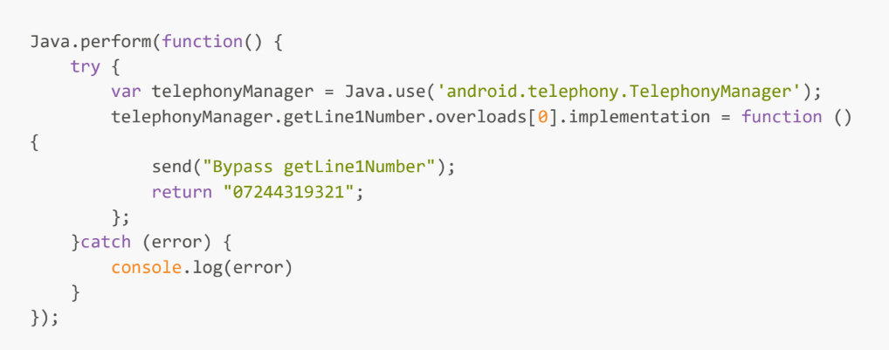

Slide 15
